Slide 1

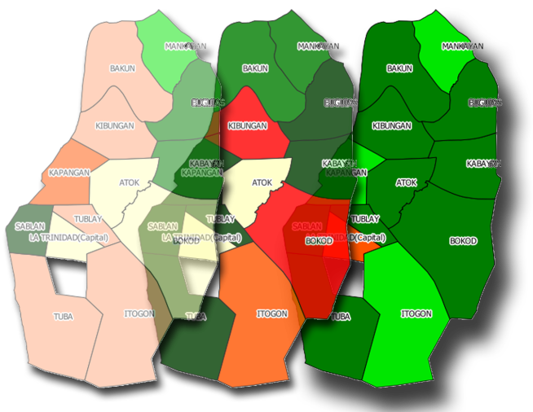
POVERTY INDEX MAPS, 2010 & 2012
Province of BENGUET
Republika ng Pilipinas
PAMBANSANG LUPON SA UGNAYANG PANG-ESTADISTIKA
(NATIONAL STATISTICAL COORDINATION BOARD)
Regional Statistical Coordinaktion Unit – Cordillera Administrative Region
http://www.nscb.gov.ph/rucar
MBN
MAPS
TABLES

Slide 2
POVERTY INDEX MAPS, 2 0 10 & 2012
Province of Benguet
Republika ng Pilipinas
PAMBANSANG LUPON SA UGNAYANG PANG-ESTADISTIKA
(NATIONAL STATISTICAL COORDINATION BOARD)
Regional Statistical Coordinaktion Unit – Cordillera Administrative Region
http://www.nscb.gov.ph/rucar
MBN
MAPS
TABLES

Slide 3
TERMS OF USE OF NSCB PUBLICATIONS
The NSCB reserves its exclusive right to reproduce all of its publications in whatever form. The recipient of complimentary copy has no right to reproduce the publication/data, recopy, lend or repackage for other parties for any commercial purposes without written permission from the NSCB. The customer may reproduce the publication only for internal use of his/her company. Should the recipient wish to show some portions of the data in his/her report/article, the title of the publication and the NSCB as publisher should always be cited.
Published by the National Statistical Coordination Board Regional Statistical Coordination Unit – Cordillera Administrative Region 39 Upper Engineer’s Hill 2600 Baguio City Philippines
SEPTEMBER 2013
Issues of this publication in printed and electronic formats (Excel/Word/PDF in CD-ROM) are available for purchase. For details please contact us at (6374) 444-9234 or at nscbcar@yahoo.com.
MBN
MAPS
TABLES

Slide 4
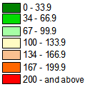
HOW TO READ THE MAPS
The municipal indices are plotted using GIS tools and technology. Maps are made for the individual indicators, the composite indices and the over-all poverty index.
Seven intervals are used in the maps. Three intervals with ranges 0-33.9 percent (best) , 34-66.9 percent (better) and 67-99.9 percent (good) represent the performance of the municipalities whose achievements are better than the average provincial values. The 100-133.9 percent range would include the municipalities with performance at least equal to but not more than one-and-a-half times the provincial value. Similarly, the 134-166.9 percent (bad), 167-199.9 percent (worse) and 200 percent and over (worst) ranges would indicate the municipalities that are above the provincial average.
LEGEND
RANGE
RATING
Best
Better
Good
Average
Bad
Worse
and above
Worst
No data
Province = 100
The poverty maps applied a red to green color scheme. This is to better distinguish the difference between the municipalities and readily identify municipalities that need intervention. Having seven intervals, the three classes are in the shades of red, three are in the shades of green and one that is in the middle uses the shade of light yellow. The white color is used to portray an area without and/or missing data.
The three intervals of 0-33.9 percent, 34-66.9 percent and 67-99.9 percent use the shades of green, using a darker shade of green for 0-33.9 percent, a lighter shade of green for 34-66.9 percent and the lightest shade of green for the 67-99.9 percent interval. Thus, a darker shade of green portrays the best situation as compared to the other municipalities of the province. The light yellow shade is portrayed with the values 100-133.9 percent. This range is within the provincial index of 100, meaning indices less than 100 percent indicates a better situation than the overall performance of the province. Those indices that have a higher value than 100 percent indicate a worse situation than the provincial performance. Three intervals are used for this, the 134-166.9 percent, the 167-199.9 percent and the 200 percent and over interval. The first two intervals use lighter shades of red to portray the alarming performances of the municipalities. The darkest red or maroon shade is used for the 200 percent and above interval so that it would give the viewer an instant picture of which area has an alarming situation or has the worst situation among the municipalities within the province.
MBN
MAPS
TABLES

Slide 5
2010 & 2012 MBN Data Availability For the Province of Benguet
Survival
Food and Nutrition
Newborn with Birthweight Less Than 2.5 kg
Malnourished Children 0-6 Years Old
Underweight School Children
Health
Child Deaths (Under 5 Years Old)
Infant Deaths (Below 1 Year Old)
Population to Health Worker
Ratio
Water and Sanitation
HH with No Access to Safe Water
HH with No Access to Sanitary Toilet
Enabling
Basic Education
Elementary Non-survival
Domestic Violence Reported to the Police
Minimum
Basic Needs
Framework (MBN
Security
Peace and Order
Crime Against Person
Crime Against Property
MBN
MAPS
TABLES

Slide 6
POVERTY INDEX MAPS
Map 1 | Newborn with Birthweight Less Than 2.5Kgs, Province of Benguet: 2010 & 2012
Map 2 | Malnourished Children 0-6 Years Old, Province of Benguet: 2010 & 2012
Map 3 | Underweight School Children, Province of Benguet: 2010 & 2012
Map 4 | Nutrition Index, Province of Benguet: 2010 & 2012
Map 5 | Infant Deaths (Below 1 Year Old), Province of Benguet: 2010 & 2012
Map 6 | Child Deaths (Under 5 Years Old), Province of Benguet: 2010 & 2012
Map 7 | Population to Health Workers Ratio, Province of Benguet: 2010 & 2012
Map 8 | Health Index, Province of Benguet: 2010 & 2012
Map 9 | Households With No Access to Safe Water, Province of Benguet: 2010 & 2012
Map 10 | Households With No Access to Sanitary Toilet, Province of Benguet: 2010 & 2012
Map 11 | Water & Sanitation Index, Province of Benguet: 2010 & 2012
Map 12 | Crime Against Person, Province of Benguet: 2010 & 2012
Map 13 | Crime Against Property, Province of Benguet: 2010 & 2012
Map 14 | Crime Index, Province of Benguet: 2010 & 2012
Map 15 | Non-cohort Survival Rate, Province of Benguet: 2010 & 2012
Map 16 | Education Index, Province of Benguet: 2010 & 2012
Map 17 | Domestic Violence Reported to the Police, Province of Benguet: 2010 & 2012
Map 18 | Enabling Index, Province of Benguet: 2010 & 2012
Map 19 | Survival Index, Province of Benguet: 2010 & 2012
Map 20 | Security Index, Province of Benguet: 2010 & 2012
Map 21 | Poverty Index, Province of Benguet: 2010 & 2012
MBN
MAPS
TABLES

Slide 7
DATA & INDEX TABLES
Table 1 | Newborn with Birthweight Less Than 2.5Kgs, Province of Benguet: 2010 & 2012
Table 2 | Malnourished Children 0-6 Years Old, Province of Benguet: 2010 & 2012
Table 3 | Underweight School Children, Province of Benguet: 2010 & 2012
Table 4 | Nutrition Index, Province of Benguet: 2010 & 2012
Table 5 | Infant Deaths (Below 1 Year Old), Province of Benguet: 2010 & 2012
Table 6 | Child Deaths (Under 5 Years Old), Province of Benguet: 2010 & 2012
Table 7 | Population to Health Workers Ratio, Province of Benguet: 2010 & 2012
Table 8 | Health Index, Province of Benguet: 2010 & 2012
Table 9 | Households With No Access to Safe Water, Province of Benguet: 2010 & 2012
Table 10 | Households With No Access to Sanitary Toilet, Province of Benguet: 2010 & 2012
Table 11 | Water & Sanitation Index, Province of Benguet: 2010 & 2012
Table 12 | Crime Against Person, Province of Benguet: 2010 & 2012
Table 13 | Crime Against Property, Province of Benguet: 2010 & 2012
Table 14 | Crime Index, Province of Benguet: 2010 & 2012
Table 15 | Non-cohort Survival Rate, Province of Benguet: 2010 & 2012
Table 16 | Education Index, Province of Benguet: 2010 & 2012
Table 17 | Domestic Violence Reported to the Police, Province of Benguet: 2010 & 2012
Table 18 | Enabling Index, Province of Benguet: 2010 & 2012
Table 19 | Survival Index, Province of Benguet: 2010 & 2012
Table 20 | Security Index, Province of Benguet: 2010 & 2012
Table 21 | Poverty Index, Province of Benguet: 2010 & 2012
MBN
MAPS
TABLES

Slide 8
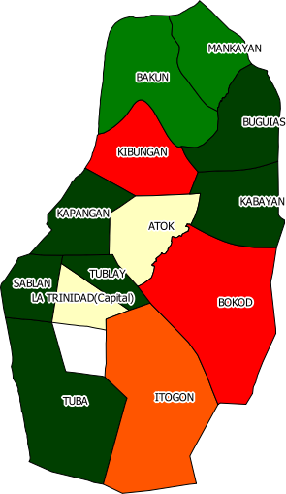
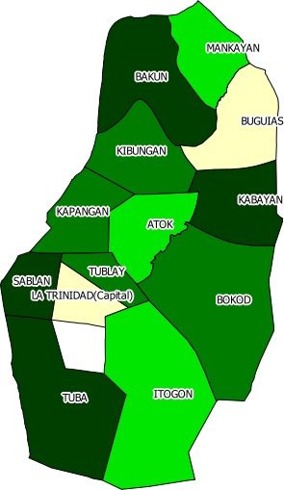
Map 1. Newborn with Birthweight Less Than 2.5 Kgs, Province of Benguet: 2010 & 2012
MBN
MAPS
TABLES

Slide 9
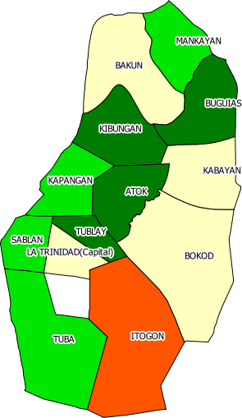
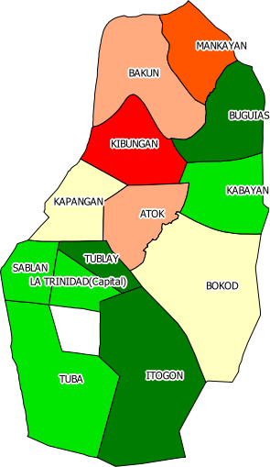
Map 2. Malnourished Children 0-6 Years Old, Province of Benguet: 2010 & 2012
MBN
MAPS
TABLES

Slide 10
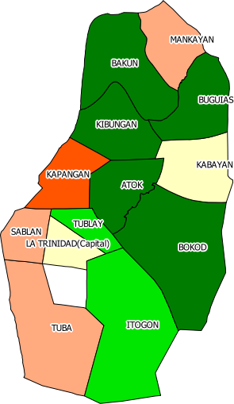
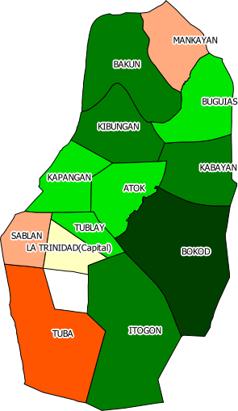
Map 3. Underweight School Children, Province of Benguet: 2010 & 2012
MBN
MAPS
TABLES

Slide 11
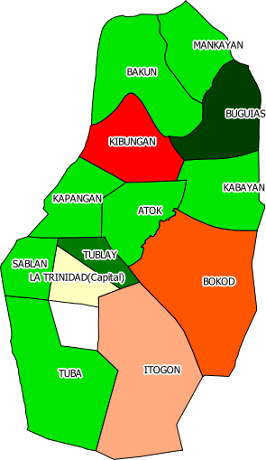
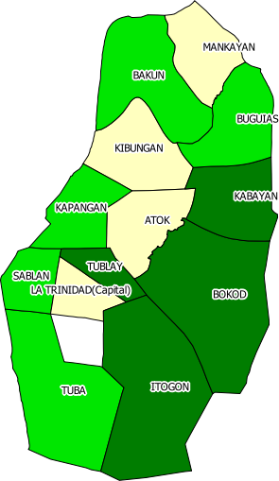
Map 4. Nutrition Index, Province of Benguet: 2010 & 2012
MBN
MAPS
TABLES

Slide 12
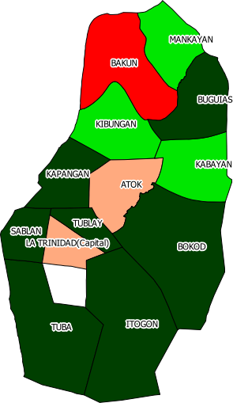
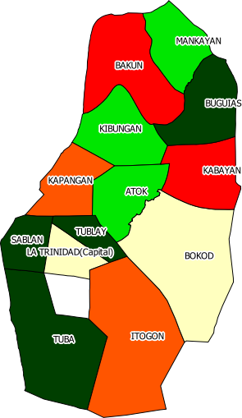
Map 5. Infant Deaths (Below 1 Year Old), Province of Benguet: 2010 & 2012
MBN
MAPS
TABLES

Slide 13
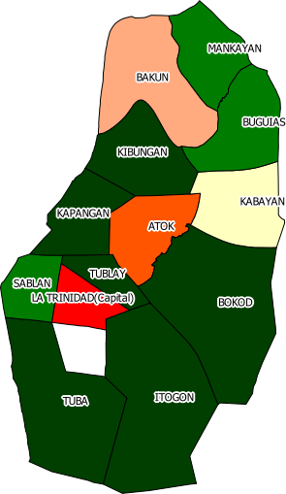
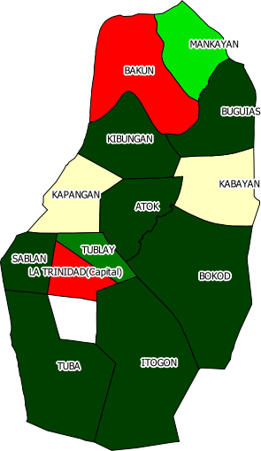
Map 6. Child Deaths (Under 5 Years Old), Province of Benguet: 2010 & 2012
MBN
MAPS
TABLES

Slide 14
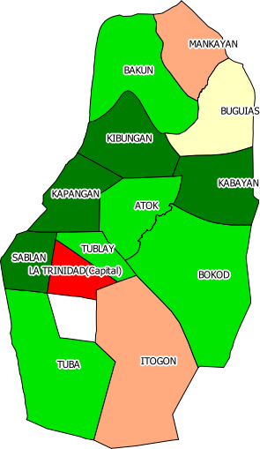
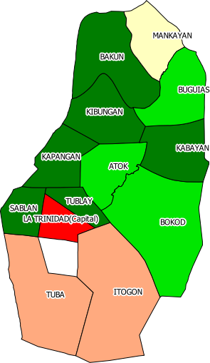
Map 7. Population to Health Workers Ratio, Province of Benguet: 2010 & 2012
MBN
MAPS
TABLES

Slide 15
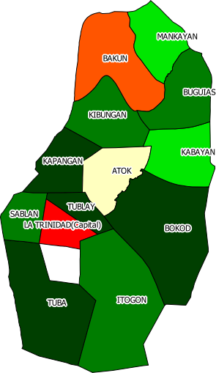
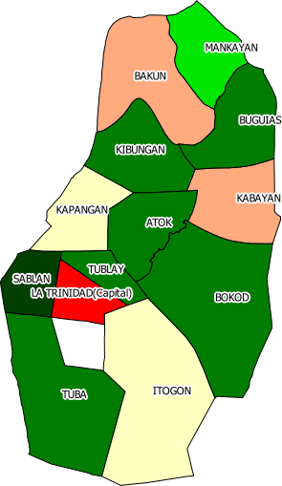
Map 8. Health Index, Province of Benguet: 2010 & 2012
MBN
MAPS
TABLES

Slide 16
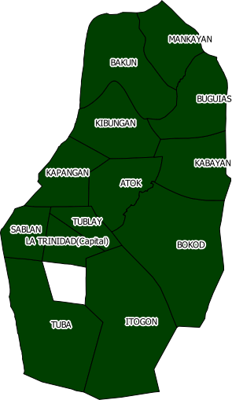
Map 9. Households With No Access to Safe Water, Province of Benguet: 2010 & 2012
MBN
MAPS
TABLES

Slide 17
Map 10. Households With No Access to Sanitary Toilet, Province of Benguet: 2010 & 2012
MBN
MAPS
TABLES

Slide 18
Map 11. Water & Sanitation Index, Province of Benguet: 2010 & 2012
MBN
MAPS
TABLES

Slide 19
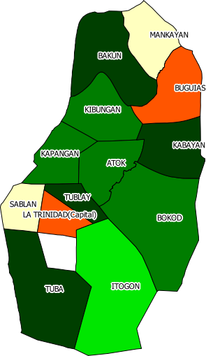
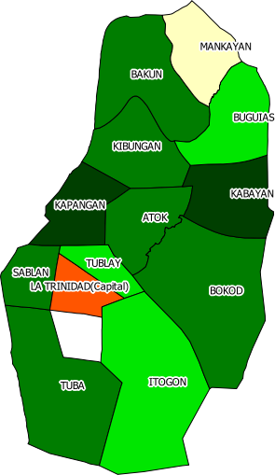
Map 12. Crime Against Person, Province of Benguet: 2010 & 2012
MBN
MAPS
TABLES

Slide 20
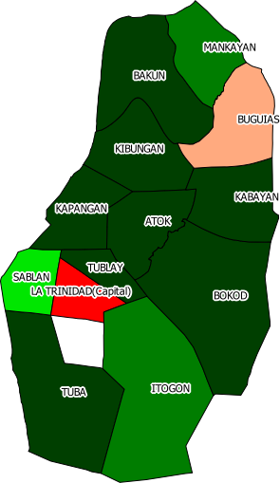
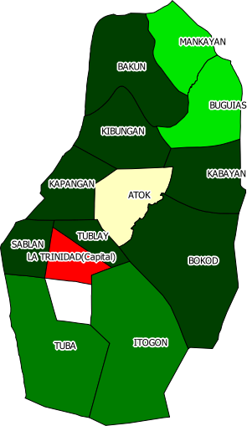
Map 13. Crime Against Property, Province of Benguet: 2010 & 2012
MBN
MAPS
TABLES

Slide 21
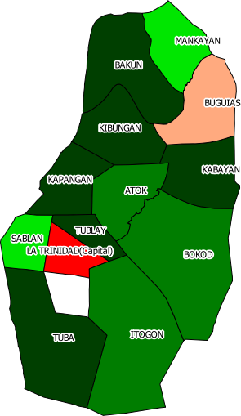
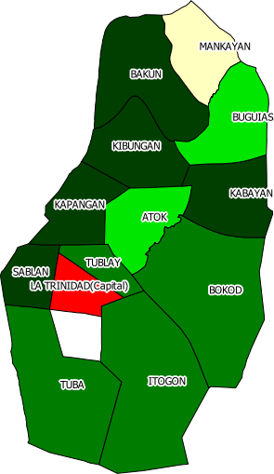
Map 14. Crime Index, Province of Benguet: 2010 & 2012
MBN
MAPS
TABLES

Slide 22
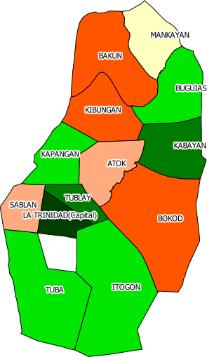
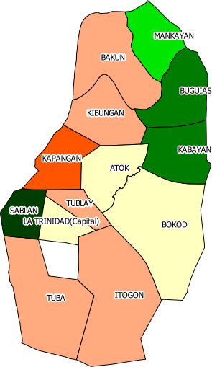
Map 15. Cohort Non-survival Rate, Province of Benguet: 2010 & 2012
MBN
MAPS
TABLES

Slide 23
Map 16. Education Index, Province of Benguet: 2010 & 2012
MBN
MAPS
TABLES

Slide 24
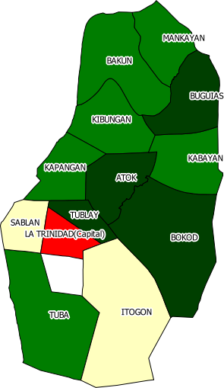
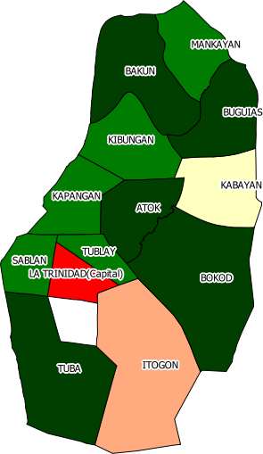
Map 17. Domestic Violence Reported to the Police, Province of Benguet: 2010 & 2012
MBN
MAPS
TABLES

Slide 25
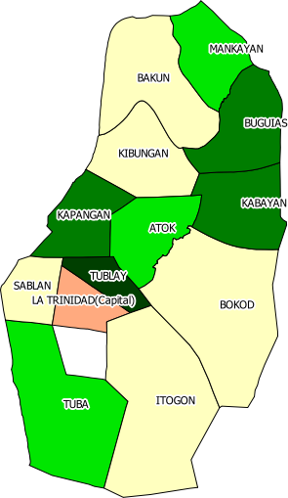
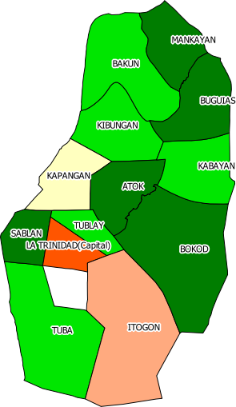
Map 18. Enabling Index, Province of Benguet: 2010 & 2012
MBN
MAPS
TABLES

Slide 26
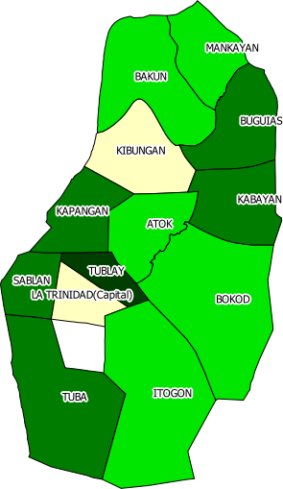
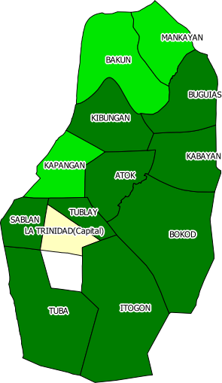
Map 19. Survival Index, Province of Benguet: 2010 & 2012
MBN
MAPS
TABLES

Slide 27
Map 20. Security Index, Province of Benguet: 2010 & 2012
MBN
MAPS
TABLES

Slide 28
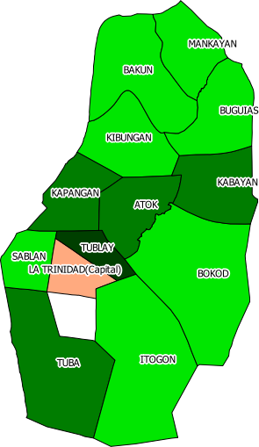
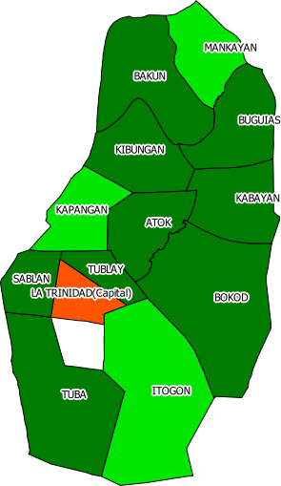
Map 21. Poverty Index, Province of Benguet: 2010 & 2012
MBN
MAPS
TABLES

Slide 29
Table 1
NEWBORN WITH BIRTHWEIGHT LESS THAN 2.5 KILOGRAMS
Benguet Province
2010 and 2012
Municipality | 2010 |  |  | 2012
 | Number | Prop (%) | Index | Number | Prop (%) | Index
Atok | 42 | 12.77 | 112.73 | 30 | 9.09 | 92.53
Bakun | 10 | 7.35 | 64.93 | 2 | 1.52 | 15.42
Bokod | 63 | 44.37 | 391.77 | 8 | 6.35 | 64.63
Buguias | 7 | 0.76 | 6.68 | 94 | 11.53 | 117.40
Itogon | 38 | 20.00 | 176.61 | 11 | 7.01 | 71.31
Kabayan | 3 | 1.97 | 17.43 | 2 | 1.83 | 18.68
Kapangan | 5 | 1.93 | 17.05 | 12 | 5.80 | 59.01
Kibungan | 133 | 76.00 | 671.10 | 9 | 5.20 | 52.95
La Trinidad | 424 | 12.14 | 107.19 | 409 | 11.77 | 119.80
Mankayan | 43 | 7.48 | 66.04 | 38 | 7.69 | 78.30
Sablan | 1 | 2.08 | 18.40 | 0 | 0.00 | 0.00
Tuba | 3 | 1.01 | 8.95 | 4 | 1.78 | 18.10
Tublay | 0 | 0.00 | 0.00 | 3 | 4.69 | 47.71
BENGUET | 772 | 11.32 | 100.00 | 622 | 9.82 | 100.00
Source of basic data: Field Health Service Information System (FHSIS)
MBN
MAPS
TABLES

Slide 30
Table 2
MALNOURISHED CHILDREN 0-6 YEARS OLD
Benguet Province
2010 and 2012
Municipality | 2010 |  |  | 2012
 | Number | Prop (%) | Index | Number | Prop (%) | Index
Atok | 40 | 1.38 | 49.20 | 59 | 3.05 | 155.01
Bakun | 84 | 3.33 | 118.66 | 46 | 2.86 | 145.68
Bokod | 75 | 3.33 | 118.73 | 27 | 2.05 | 104.49
Buguias | 68 | 1.15 | 40.91 | 63 | 1.29 | 65.88
Itogon | 375 | 5.53 | 197.07 | 66 | 0.98 | 50.01
Kabayan | 70 | 3.26 | 116.23 | 27 | 1.55 | 78.88
Kapangan | 80 | 2.64 | 94.20 | 40 | 2.04 | 103.81
Kibungan | 38 | 1.29 | 46.02 | 106 | 4.99 | 253.86
La Trinidad | 335 | 3.51 | 125.23 | 244 | 1.75 | 88.85
Mankayan | 149 | 2.51 | 89.60 | 159 | 3.29 | 167.67
Sablan | 41 | 2.66 | 94.71 | 21 | 1.95 | 99.32
Tuba | 99 | 1.99 | 70.96 | 83 | 1.67 | 84.96
Tublay | 34 | 1.33 | 47.28 | 21 | 1.14 | 58.18
BENGUET | 1,488 | 2.80 | 100.00 | 962 | 1.96 | 100.00
Source of basic data: Benguet Provincial Health Office
MBN
MAPS
TABLES

Slide 31
Table 3
UNDERWEIGHT SCHOOL CHILDREN
Benguet Province
2010 and 2012
Municipality | 2010 |  |  | 2012
 | Number | Prop (%) | Index | Number | Prop (%) | Index
Atok | 19 | 0.67 | 40.91 | 35 | 1.22 | 83.89
Bakun | 25 | 1.04 | 63.66 | 21 | 0.94 | 64.81
Bokod | 23 | 1.05 | 64.35 | 4 | 0.20 | 13.57
Buguias | 43 | 0.75 | 45.95 | 58 | 0.98 | 67.78
Itogon | 84 | 1.27 | 78.18 | 62 | 0.82 | 56.72
Kabayan | 39 | 1.87 | 115.14 | 15 | 0.72 | 49.39
Kapangan | 88 | 3.02 | 185.43 | 34 | 1.11 | 76.25
Kibungan | 26 | 0.91 | 55.80 | 27 | 0.97 | 66.62
La Trinidad | 166 | 1.75 | 107.85 | 202 | 1.88 | 129.48
Mankayan | 129 | 2.30 | 141.26 | 129 | 2.23 | 153.80
Sablan | 35 | 2.29 | 140.98 | 33 | 2.18 | 150.41
Tuba | 130 | 2.67 | 164.11 | 137 | 2.68 | 184.51
Tublay | 32 | 1.32 | 81.41 | 30 | 1.18 | 81.17
BENGUET | 839 | 1.63 | 100.00 | 787 | 1.45 | 100.00
Source of basic data: DepEd, Division of Benguet
MBN
MAPS
TABLES

Slide 32
Table 4
NUTRITION INDEX
Benguet Province
2010 and 2012
Municipality | 2010 | 2012
Atok | 67.61 | 110.48
Bakun | 82.41 | 75.30
Bokod | 191.62 | 60.90
Buguias | 31.18 | 83.68
Itogon | 150.62 | 59.35
Kabayan | 82.93 | 48.98
Kapangan | 98.89 | 79.69
Kibungan | 257.64 | 124.48
La Trinidad | 113.42 | 112.71
Mankayan | 98.97 | 133.26
Sablan | 84.70 | 83.24
Tuba | 81.34 | 95.85
Tublay | 42.90 | 62.35
BENGUET | 100.00 | 100.00
MBN
MAPS
TABLES

Slide 33
Table 5
INFANT DEATHS (BELOW 1 YEAR OLD)
Benguet Province
2010 and 2012
Municipality | 2010 |  |  |  | 2012
 | Number | No. of Livebirths | Prop (%) | Index | Number | Number of Livebirths | Prop (%) | Index
Atok | 4 | 329 | 12.16 | 153.48 | 2 | 330 | 6.06 | 83.41
Bakun | 3 | 136 | 22.06 | 278.47 | 2 | 132 | 15.15 | 208.53
Bokod | - | 142 | 0.00 | 0.00 | 1 | 126 | 7.94 | 109.23
Buguias | 2 | 926 | 2.16 | 27.27 | 2 | 815 | 2.45 | 33.77
Itogon | - | 190 | 0.00 | 0.00 | 2 | 157 | 12.74 | 175.33
Kabayan | 1 | 152 | 6.58 | 83.05 | 2 | 109 | 18.35 | 252.53
Kapangan | - | 259 | 0.00 | 0.00 | 3 | 207 | 14.49 | 199.46
Kibungan | 1 | 175 | 5.71 | 72.14 | 1 | 173 | 5.78 | 79.56
La Trinidad | 39 | 3,493 | 11.17 | 140.95 | 28 | 3,475 | 8.06 | 110.90
Mankayan | 4 | 575 | 6.96 | 87.82 | 3 | 494 | 6.07 | 83.58
Sablan | - | 48 | 0.00 | 0.00 | - | 24 | 0.00 | 0.00
Tuba | - | 296 | 0.00 | 0.00 | - | 225 | 0.00 | 0.00
Tublay | - | 96 | 0.00 | 0.00 | - | 64 | 0.00 | 0.00
BENGUET | 54 | 6,817 | 7.92 | 100.00 | 46 | 6,331 | 7.27 | 100.00
Source of basic data: Field Health Service Information System (FHSIS)
MBN
MAPS
TABLES

Slide 34
Table 6
CHILD DEATHS (UNDER 5 YEARS OLD)
Benguet Province
2010 and 2012
Municipality | 2010 |  |  |  | 2012
 | Number | Total No. of Children 5 Years Old and Below | Prop (%) | Index | Number | Total No. of Children 5 Years Old and Below | Prop (%) | Index
Atok | 6 | 2,831 | 0.21 | 174.88 | - | 2,710 | 0.00 | 0.00
Bakun | 4 | 2,076 | 0.19 | 158.99 | 4 | 1,987 | 0.20 | 240.31
Bokod | - | 1,989 | 0.00 | 0.00 | - | 1,905 | 0.00 | 0.00
Buguias | 3 | 5,639 | 0.05 | 43.90 | 1 | 5,398 | 0.02 | 22.11
Itogon | 1 | 7,938 | 0.01 | 10.39 | - | 7,600 | 0.00 | 0.00
Kabayan | 3 | 2,098 | 0.14 | 117.99 | 2 | 2,009 | 0.10 | 118.84
Kapangan | 1 | 3,083 | 0.03 | 26.76 | 3 | 2,951 | 0.10 | 121.36
Kibungan | 1 | 2,556 | 0.04 | 32.28 | - | 2,447 | 0.00 | 0.00
La Trinidad | 44 | 11,551 | 0.38 | 314.31 | 29 | 11,059 | 0.26 | 313.03
Mankayan | 4 | 5,864 | 0.07 | 56.29 | 4 | 5,614 | 0.07 | 85.05
Sablan | 1 | 1,640 | 0.06 | 50.31 | - | 1,570 | 0.00 | 0.00
Tuba | - | 6,521 | 0.00 | 0.00 | 1 | 6,243 | 0.02 | 19.12
Tublay | - | 2,324 | 0.00 | 0.00 | 1 | 2,225 | 0.04 | 53.65
BENGUET | 68 | 56,110 | 0.12 | 100.00 | 45 | 53,718 | 0.08 | 100.00
Source of basic data: Field Health Service Information System (FHSIS)
MBN
MAPS
TABLES

Slide 35
Table 7
POPULATION TO HEALTH WORKERS RATIO
Benguet Province
2010 and 2012
Municipality | 2010 |  |  | 2012
 | Total Health Workers | Ratio | Index | Total Health Workers | Ratio | Index
Atok | 111 | 193.52 | 70.64 | 84 | 239.00 | 77.48
Bakun | 97 | 192.82 | 70.38 | 92 | 160.00 | 51.87
Bokod | 61 | 273.59 | 99.86 | 58 | 243.24 | 78.86
Buguias | 129 | 340.46 | 124.27 | 131 | 305.25 | 98.96
Itogon | 134 | 375.18 | 136.95 | 121 | 465.23 | 150.83
Kabayan | 120 | 132.59 | 48.40 | 110 | 135.25 | 43.85
Kapangan | 146 | 153.68 | 56.10 | 123 | 177.72 | 57.62
Kibungan | 147 | 148.40 | 54.17 | 92 | 196.99 | 63.86
La Trinidad | 92 | 768.20 | 280.40 | 88 | 930.85 | 301.78
Mankayan | 116 | 378.73 | 138.24 | 127 | 327.44 | 106.16
Sablan | 72 | 158.85 | 57.98 | 71 | 163.85 | 53.12
Tuba | 136 | 271.02 | 98.93 | 110 | 420.38 | 136.29
Tublay | 74 | 256.76 | 93.72 | 83 | 198.54 | 64.37
BENGUET | 1,435 | 273.96 | 100.00 | 1,290 | 308.45 | 100.00
Source of basic data: Field Health Service Information System (FHSIS)
MBN
MAPS
TABLES

Slide 36
Table 8
HEALTH INDEX
Benguet Province
2010 and 2012
Municipality | 2010 | 2012
Atok | 133.00 | 53.63
Bakun | 169.28 | 166.90
Bokod | 33.29 | 62.70
Buguias | 65.15 | 51.62
Itogon | 49.11 | 108.72
Kabayan | 83.15 | 138.41
Kapangan | 27.62 | 126.15
Kibungan | 52.86 | 47.81
La Trinidad | 245.22 | 241.90
Mankayan | 94.12 | 91.60
Sablan | 36.10 | 17.71
Tuba | 32.98 | 51.80
Tublay | 31.24 | 39.34
BENGUET | 100.00 | 100.00
MBN
MAPS
TABLES

Slide 37
Table 9
HOUSEHOLDS WITH NO ACCESS TO SAFE WATER
Benguet Province
2010 and 2012
Municipality | 2010 |  | 2012
 | Number | Index | Number | Index
Atok | 2,471 | 4.47 | 645 | 1.47
Bakun | 2,300 | 4.16 | 681 | 1.56
Bokod | 2,456 | 4.44 | 2,014 | 4.60
Buguias | 6,961 | 12.60 | 6,971 | 15.93
Itogon | 9,413 | 17.03 | 9,079 | 20.75
Kabayan | 2,267 | 4.10 | 1,748 | 4.00
Kapangan | 3,806 | 6.89 | 2,995 | 6.85
Kibungan | 3,110 | 5.63 | 2,506 | 5.73
La Trinidad | 2,300 | 4.16 | 1,457 | 3.33
Mankayan | 7,239 | 13.10 | 5,233 | 11.96
Sablan | 2,025 | 3.66 | 877 | 2.00
Tuba | 8,050 | 14.57 | 8,363 | 19.12
Tublay | 2,869 | 5.19 | 1,181 | 2.70
BENGUET | 55,267 | 100.00 | 43,750 | 100.00
Source of basic data: Field Health Service Information System (FHSIS)
MBN
MAPS
TABLES

Slide 38
Table 10
HOUSEHOLDS WITH NO ACCESS TO SANITARY TOILET
Benguet Province
2010 and 2012
Municipality | 2010 |  | 2012
 | Number | Index | Number | Index
Atok | 610 | 4.16 | 685 | 4.10
Bakun | 352 | 2.40 | 508 | 3.04
Bokod | 847 | 5.78 | 955 | 5.72
Buguias | 2,430 | 16.58 | 2,618 | 15.69
Itogon | 1,530 | 10.44 | 3,141 | 18.82
Kabayan | 945 | 6.45 | 713 | 4.27
Kapangan | 860 | 5.87 | 1,517 | 9.09
Kibungan | 848 | 5.79 | 1,179 | 7.06
La Trinidad | 1,591 | 10.86 | 502 | 3.01
Mankayan | 1,449 | 9.89 | 1,921 | 11.51
Sablan | 357 | 2.44 | 541 | 3.24
Tuba | 2,462 | 16.80 | 1,674 | 10.03
Tublay | 372 | 2.54 | 736 | 4.41
BENGUET | 14,653 | 100.00 | 16,690 | 100.00
Source of basic data: Field Health Service Information System (FHSIS)
MBN
MAPS
TABLES

Slide 39
Table 11
WATER AND SANITATION INDEX
Benguet Province
2010 and 2012
Municipality | 2010 | 2012
Atok | 4.32 | 2.79
Bakun | 3.28 | 2.30
Bokod | 5.11 | 5.16
Buguias | 14.59 | 15.81
Itogon | 13.74 | 19.79
Kabayan | 5.28 | 4.13
Kapangan | 6.38 | 7.97
Kibungan | 5.71 | 6.40
La Trinidad | 7.51 | 3.17
Mankayan | 11.49 | 11.74
Sablan | 3.05 | 2.62
Tuba | 15.68 | 14.57
Tublay | 3.86 | 3.55
BENGUET | 100.00 | 100.00
MBN
MAPS
TABLES

Slide 40
Table 12
CRIME AGAINST PERSON
Benguet Province
2010 and 2012
Municipality | 2010 |  |  | 2012
 | Number | Prop (%) | Index | Number | Prop (%) | Index
Atok | 9 | 4.68 | 40.63 | 5 | 2.41 | 44.62
Bakun | 5 | 3.68 | 31.97 | 4 | 3.06 | 56.62
Bokod | 9 | 7.12 | 61.81 | 5 | 3.60 | 66.52
Buguias | 78 | 19.86 | 172.54 | 17 | 4.58 | 84.64
Itogon | 48 | 8.58 | 74.51 | 24 | 4.57 | 84.53
Kabayan | 4 | 2.94 | 25.57 | 2 | 1.47 | 27.15
Kapangan | 8 | 3.98 | 34.60 | 3 | 1.53 | 28.29
Kibungan | 9 | 5.34 | 46.40 | 4 | 2.37 | 43.77
La Trinidad | 215 | 20.06 | 174.25 | 106 | 9.55 | 176.40
Mankayan | 44 | 12.36 | 107.41 | 25 | 6.72 | 124.26
Sablan | 14 | 13.32 | 115.71 | 3 | 2.56 | 47.33
Tuba | 16 | 3.73 | 32.42 | 14 | 3.25 | 60.12
Tublay | 6 | 3.62 | 31.48 | 8 | 4.93 | 91.04
BENGUET | 465 | 11.51 | 100.00 | 220 | 5.41 | 100.00
Source of basic data: Police Provincial Office - Benguet
MBN
MAPS
TABLES

Slide 41
Table 13
CRIME AGAINST PROPERTY
Benguet Province
2010 and 2012
Municipality | 2010 |  |  | 2012
 | Number | Prop (%) | Index | Number | Prop (%) | Index
Atok | 9 | 4.68 | 32.92 | 18 | 8.69 | 115.86
Bakun | 1 | 0.74 | 5.18 | - | 0.00 | 0.00
Bokod | 5 | 3.95 | 27.82 | 2 | 1.44 | 19.19
Buguias | 75 | 19.10 | 134.40 | 23 | 6.20 | 82.60
Itogon | 37 | 6.61 | 46.53 | 14 | 2.67 | 35.57
Kabayan | 1 | 0.74 | 5.18 | 2 | 1.47 | 19.58
Kapangan | 5 | 2.49 | 17.52 | 3 | 1.53 | 20.40
Kibungan | 4 | 2.37 | 16.71 | - | 0.00 | 0.00
La Trinidad | 389 | 36.29 | 255.40 | 199 | 17.92 | 238.88
Mankayan | 20 | 5.62 | 39.55 | 27 | 7.26 | 96.80
Sablan | 11 | 10.47 | 73.65 | 1 | 0.85 | 11.38
Tuba | 11 | 2.57 | 18.06 | 12 | 2.79 | 37.17
Tublay | 6 | 3.62 | 25.51 | 4 | 2.46 | 32.84
BENGUET | 574 | 14.21 | 100.00 | 305 | 7.50 | 100.00
Source of basic data: Police Provincial Office - Benguet
MBN
MAPS
TABLES

Slide 42
Table 14
CRIME INDEX
Benguet Province
2010 and 2012
Municipality | 2010 | 2012
Atok | 36.77 | 80.24
Bakun | 18.57 | 28.31
Bokod | 44.82 | 42.86
Buguias | 153.47 | 83.62
Itogon | 60.52 | 60.05
Kabayan | 15.38 | 23.36
Kapangan | 26.06 | 24.34
Kibungan | 31.55 | 21.88
La Trinidad | 214.82 | 207.64
Mankayan | 73.48 | 110.53
Sablan | 94.68 | 29.35
Tuba | 25.24 | 48.64
Tublay | 28.49 | 61.94
BENGUET | 100.00 | 100.00
MBN
MAPS
TABLES

Slide 43
Table 15
COHORT NON-SURVIVAL RATE
Benguet Province
2010 and 2012
Municipality | 2010 |  | 2012
 | Non-Cohort Survival Rate | Index | Non-Cohort Survival Rate | Index
Atok | 39.77 | 136.11 | 24.35 | 104.42
Bakun | 53.00 | 181.38 | 36.61 | 156.99
Bokod | 57.78 | 197.74 | 23.89 | 102.44
Buguias | 23.08 | 78.99 | 12.16 | 52.14
Itogon | 26.19 | 89.63 | 32.35 | 138.72
Kabayan | 12.62 | 43.19 | 8.54 | 36.62
Kapangan | 24.56 | 84.05 | 42.16 | 180.79
Kibungan | 51.66 | 176.80 | 32.32 | 138.59
La Trinidad | 8.38 | 28.68 | 28.70 | 123.07
Mankayan | 33.53 | 114.75 | 17.29 | 74.14
Sablan | 40.42 | 138.33 | 6.65 | 28.52
Tuba | 26.59 | 91.00 | 32.92 | 141.17
Tublay | 15.67 | 53.63 | 32.10 | 137.65
BENGUET | 29.22 | 100.00 | 23.32 | 100.00
Source of basic data: Field Health Service Information System (FHSIS)
MBN
MAPS
TABLES

Slide 44
Table 16
EDUCATION INDEX
Benguet Province
2010 and 2012
Municipality | 2010 | 2012
Atok | 136.11 | 104.42
Bakun | 181.38 | 156.99
Bokod | 197.74 | 102.44
Buguias | 78.99 | 52.14
Itogon | 89.63 | 138.72
Kabayan | 43.19 | 36.62
Kapangan | 84.05 | 180.79
Kibungan | 176.80 | 138.59
La Trinidad | 28.68 | 123.07
Mankayan | 114.75 | 74.14
Sablan | 138.33 | 28.52
Tuba | 91.00 | 141.17
Tublay | 53.63 | 137.65
BENGUET | 100.00 | 100.00
MBN
MAPS
TABLES

Slide 45
Table 17
DOMESTIC VIOLENCE REPORTED TO THE POLICE
Benguet Province
2010 and 2012
Municipality | 2010 |  |  |  | 2012
 | Number | Total Number of Households | Prop (%) | Index | Number | Total Number of Households | Prop (%) | Index
Atok | 1 | 3,495 | 0.03 | 13.39 | 2 | 3,346 | 0.06 | 22.14
Bakun | 2 | 2,563 | 0.08 | 36.52 | - | 2,451 | 0.00 | 0.00
Bokod | 1 | 2,456 | 0.04 | 19.06 | 2 | 2,782 | 0.07 | 26.63
Buguias | 2 | 6,961 | 0.03 | 13.45 | 4 | 8,547 | 0.05 | 17.34
Itogon | 27 | 9,800 | 0.28 | 128.95 | 48 | 11,574 | 0.41 | 153.65
Kabayan | 3 | 2,590 | 0.12 | 54.21 | 8 | 2,480 | 0.32 | 119.51
Kapangan | 4 | 3,806 | 0.11 | 49.19 | 5 | 4,096 | 0.12 | 45.22
Kibungan | 4 | 3,154 | 0.13 | 59.36 | 5 | 3,367 | 0.15 | 55.02
La Trinidad | 81 | 14,260 | 0.57 | 265.85 | 117 | 17,412 | 0.67 | 248.94
Mankayan | 10 | 7,239 | 0.14 | 64.65 | 7 | 7,395 | 0.09 | 35.07
Sablan | 5 | 2,025 | 0.25 | 115.56 | 3 | 1,939 | 0.15 | 57.32
Tuba | 8 | 8,050 | 0.10 | 46.51 | 5 | 8,901 | 0.06 | 20.81
Tublay | - | 2,869 | 0.00 | 0.00 | 3 | 3,140 | 0.10 | 35.40
BENGUET | 148 | 69,268 | 0.21 | 100.00 | 209 | 77,430 | 0.27 | 100.00
Source of basic data: Police Abra Office
MBN
MAPS
TABLES

Slide 46
Table 18
ENABLING INDEX
Benguet Province
2010 and 2012
Municipality | 2010 | 2012
Atok | 74.75 | 63.28
Bakun | 108.95 | 78.49
Bokod | 108.40 | 64.54
Buguias | 46.22 | 34.74
Itogon | 109.29 | 146.18
Kabayan | 48.70 | 78.07
Kapangan | 66.62 | 113.01
Kibungan | 118.08 | 96.80
La Trinidad | 147.26 | 186.01
Mankayan | 89.70 | 54.61
Sablan | 126.95 | 42.92
Tuba | 68.76 | 80.99
Tublay | 26.81 | 86.52
BENGUET | 100.00 | 100.00
MBN
MAPS
TABLES

Slide 47
Table 19
SURVIVAL INDEX
Benguet Province
2010 and 2012
Municipality | 2010 | 2012
Atok | 68.31 | 55.63
Bakun | 84.99 | 81.50
Bokod | 76.67 | 42.92
Buguias | 36.97 | 50.37
Itogon | 71.16 | 62.62
Kabayan | 57.12 | 63.84
Kapangan | 44.30 | 71.27
Kibungan | 105.40 | 59.56
La Trinidad | 122.05 | 119.26
Mankayan | 68.19 | 78.86
Sablan | 41.28 | 34.52
Tuba | 43.33 | 54.08
Tublay | 26.00 | 35.08
BENGUET | 100.00 | 100.00
MBN
MAPS
TABLES

Slide 48
Table 20
SECURITY INDEX
Benguet Province
2010 and 2012
Municipality | 2010 | 2012
Atok | 36.77 | 80.24
Bakun | 18.57 | 28.31
Bokod | 44.82 | 42.86
Buguias | 153.47 | 83.62
Itogon | 60.52 | 60.05
Kabayan | 15.38 | 23.36
Kapangan | 26.06 | 24.34
Kibungan | 31.55 | 21.88
La Trinidad | 214.82 | 207.64
Mankayan | 73.48 | 110.53
Sablan | 94.68 | 29.35
Tuba | 25.24 | 48.64
Tublay | 28.49 | 61.94
BENGUET | 100.00 | 100.00
MBN
MAPS
TABLES

Slide 49
Table 21
POVERTY INDEX
Benguet Province
2010 and 2012
Municipality | 2010 | 2012
Atok | 59.94 | 66.38
Bakun | 70.84 | 62.77
Bokod | 76.63 | 50.11
Buguias | 78.89 | 56.24
Itogon | 80.32 | 89.62
Kabayan | 40.40 | 55.09
Kapangan | 45.66 | 69.54
Kibungan | 85.01 | 59.42
La Trinidad | 161.38 | 170.97
Mankayan | 77.12 | 81.33
Sablan | 87.63 | 35.60
Tuba | 45.78 | 61.24
Tublay | 27.10 | 61.18
BENGUET | 100.00 | 100.00
MBN
MAPS
TABLES

Slide 50
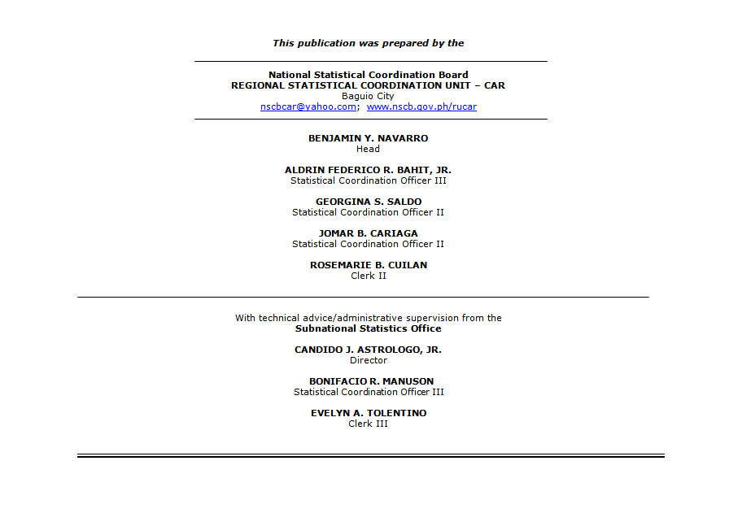
MBN
MAPS
TABLES

Slide 51
For Inquiries:
NATIONAL STATISITICAL COORDINATION BOARD
NATIONAL STATISTICAL INFORMATION CENTER
Regional Statistical Coordination Unit – Cordillera Administrative Region
2/F JA Apartment, #39 Upper Engineer’s Hill
2600 Baguio City, Philippines
Telefax No.: +63 74 444 9234
E-mail address: nscbcar@yahoo.com
URL: www.nscb.gov.ph/rucar Facebook: National Statistical Coordination Board Cordillera Administrative Region
Twitter: @NSCBCordillera
MBN
MAPS
TABLES

